Slide 1
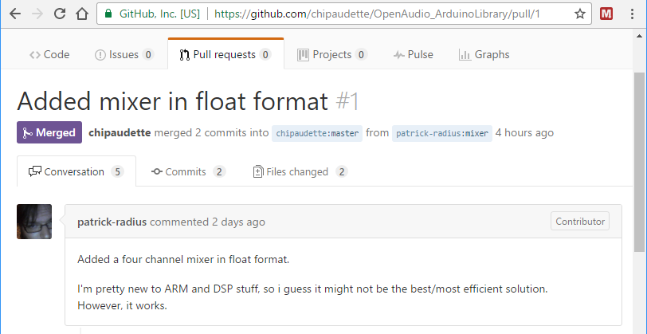

Slide 2
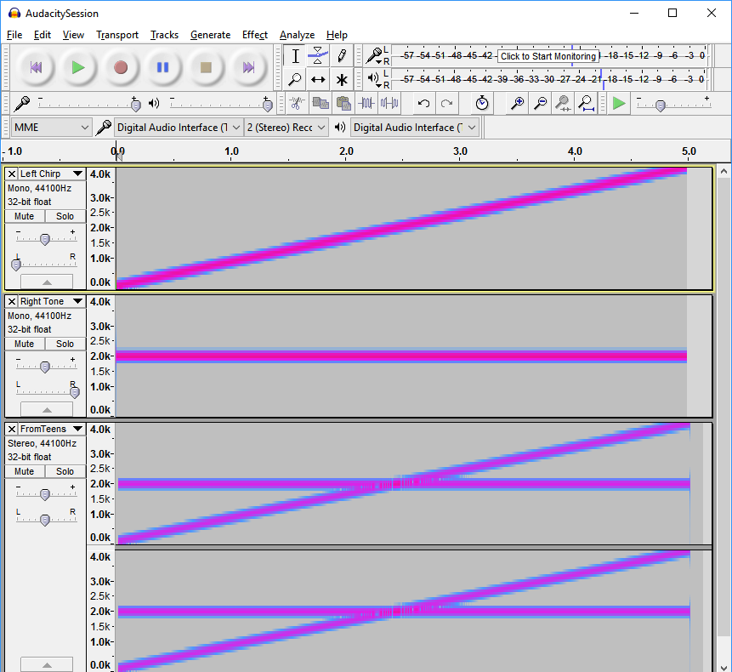
Left Channel
To Teensy
Right Channel
Left Channel
From Teensy
Right Channel

